Slide 1
Chapter 4
Mobile Radio Propagation Large Scale Path Loss
Basic content
Radio Wave Propagation
Basic Propagation Mechanisms
Free Space Propagation Model
Indoor and Outdoor Propagation Models
Signal Penetration into Buildings

Slide 2
Introduction to Radio Wave Propagation
Radio propagation is the way radio signals are transmitted from one point to another inside the earth's atmosphere or free space.
Since these are electromagnetic waves, they exhibit properties such as reflection, refraction, diffraction, absorption, polarization and scattering.
Radio propagation is the behavior of radio waves as they travel, or are propagated, from one point to another in vacuum, or into various parts of the atmosphere.

Slide 3
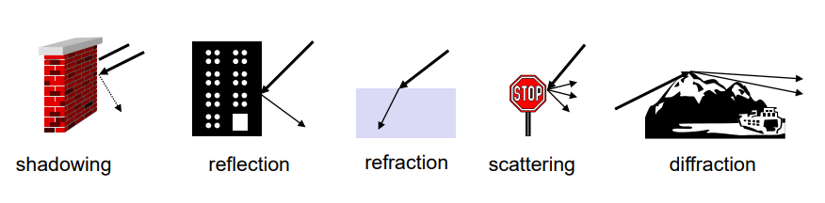
Signal propagation
• Propagation in free space always like light (straight line)
• In real world Receiving power influenced by
fading (frequency dependent)
shadowing
reflection at large obstacles
refraction depending on the density of a medium
scattering at small obstacles
diffraction at edges

Slide 4
Cont..
Many factors affect a radio wave in its path between the transmitter and receiver, including:
Absorption, Fading, Transmission losses, and. Electromagnetic interference
The properties of the path by which the radio signals will propagate governs the level and quality of the received signal.
Reflection, refraction and diffraction may occur.
The resultant radio signal may also be a combination of several signals that have travelled by different paths.

Slide 5
Three Basic Propagation Mechanisms
Reflection, diffraction, and scattering are the three basic propagation mechanisms which impact propagation in a mobile communication system.
Reflection : occurs when signal encounters large surfaces. The surface is large relative to the wavelength of the signals.
Diffraction :occurs at the edge of an impenetrable body that is large compared to the wavelength of the radio wave.
Scattering : occurs when incoming signal hits an object whose size is in the order of the wavelength of the signal or less.

Slide 6
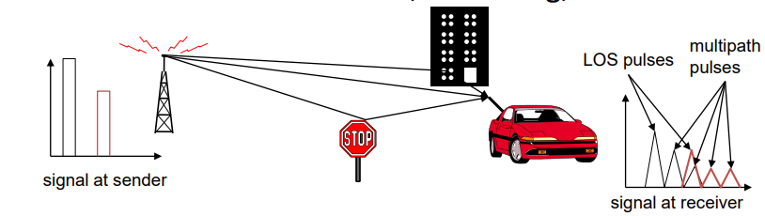
Multipath propagation
• Signal can take many different paths between sender and receiver due to reflection, scattering, diffraction
Time dispersion: signal is dispersed over time
interference with “neighbor” symbols, Inter Symbol Interference (ISI)
The signal reaches a receiver directly and phase shifted
distorted signal depending on the phases of the different parts

Slide 7
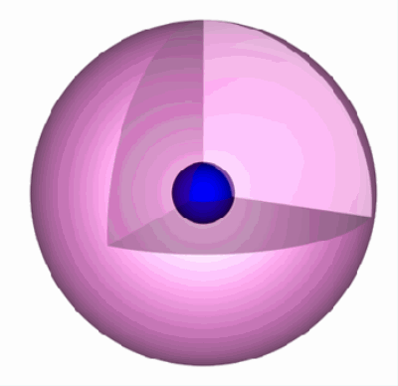
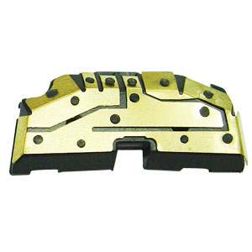
Antennas and Signal Propagation
An antenna is an electrical conductor or system of conductors
Transmission - radiates electromagnetic energy into space
Reception - collects electromagnetic energy from space
In two-way communication, the same antenna can be used for transmission and reception
Types of Antennas:
Isotropic antenna (idealized)
Radiates power equally in all directions (it is three dimensional)
Dipole antennas
Half-wave dipole antenna (or Hertz antenna)
Quarter-wave vertical antenna

Slide 8
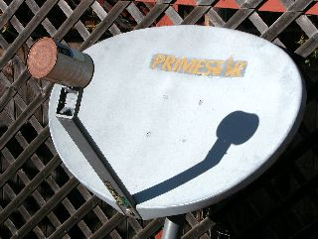
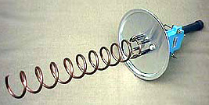
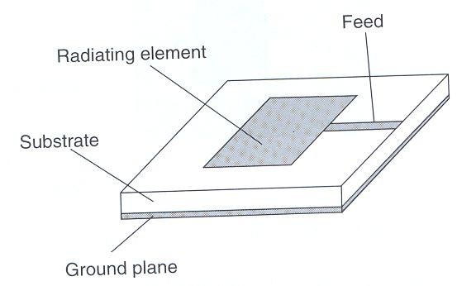
Parabolic Reflective Antenna
Helical antenna
Patch (micro strip ) antenna
Multiband antenna: for GSM 900+GSM 1800+GSM 1900+Bluetooth; or GSM and 3G

Slide 9
Types of radio wave propagation
Radio waves can propagate from transmitter to receiver in three ways: through.
Ground waves or surface waves(up to 2MHz) ,
Sky wave or ionosphere wave propagation(2MHz to 30MHz)
Free Space wave or line of sight propagation(above 30MHz)
Ground waves
exist only for vertical polarization and produced by vertical antennas.
when the transmitting and receiving antennas are close to the surface of the earth.

Slide 11
Radio frequency bands
Classification Band | Initials | Frequency Range |  | Characteristics
Extremely low | ELF | < 300 Hz |  | Ground wave
Infra low | ILF | 300 Hz - 3 kHz
Very low | VLF | 3 kHz - 30 kHz
Low | LF | 30 kHz - 300 kHz
Medium | MF | 300 kHz - 3 MHz |  | Ground/Sky wave
High | HF | 3 MHz - 30 MHz |  | Sky wave
Very high | VHF | 30 MHz - 300 MHz |  | Space wave
Ultra high | UHF | 300 MHz - 3 GHz
Super high | SHF | 3 GHz - 30 GHz
Extremely high | EHF | 30 GHz - 300 GHz
Tremendously high | THF | 300 GHz - 3000 GHz

Slide 12
Ground wave propagation
is a type of radio propagation which is also known as a surface wave.
These waves propagate over the earth's surface in low and medium frequencies.
These are mainly used for transmission between the surface of the earth and the ionosphere.

Slide 13
Cont.
Ground wave propagation is a form of signal propagation where the signal travels over the surface of the ground, and as a result it is used to provide regional coverage on the long and medium wave bands.
Ground wave propagation is particularly important on the LF and MF portion of the radio spectrum.
Ground wave radio propagation is used to provide relatively local radio communications coverage, especially by radio broadcast stations that require to cover a particular locality.

Slide 14
Cont.
Ground wave radio signal propagation is ideal for relatively short distance propagation on these frequencies during the daytime.
Sky-wave ionosphere propagation is not possible during the day because of the attenuation of the signals on these frequencies caused by the D region in the ionosphere.
In view of this, radio communications stations need to rely on the ground-wave propagation to achieve their coverage.

Slide 15
Cont.
A ground wave radio signal is made up from a number of parts.
If the antennas are in the line of sight then there will be a direct wave as well as a reflected signal.
As the names suggest the direct signal is one that travels directly between the two antenna and is not affected by the locality.
There will also be a reflected signal as the transmission will be reflected by a number of objects including the earth's surface and any hills, or large buildings. That may be present.

Slide 16
Cont..
Free Space wave propagation is a type of radio wave propagation in which radio waves go directly from the transmitting antenna to the receiving antenna or are reflected from the ground.
It's also known as line-of-sight communication.
Space wave propagation is the term used for radio signals travelling through space.

Slide 17
Cont.
The free space propagation model assumes a transmit antenna and a receive antenna to be located in an otherwise empty environment.
Neither absorbing obstacles nor reflecting surfaces are considered.
In particular, the influence of the earth surface is assumed to be entirely absent.
The free space propagation model is used to predict received signal strength when the transmitter and receiver have a clear and unobstructed line-of-sight path between them

Slide 18
Cont..
Free Space wave propagation is defined for the radio waves that occur within the 20km of the atmosphere ie; troposphere, comprising of a direct and reflected waves.
These waves are also known as tropospheric propagation as they can travel directly from the earth’s surface to the troposphere surface of the earth.
It is also known as a line of sight propagation as the signals are sent in a straight line from the transmitter to the receiver.

Slide 19
Cont.
There are two types of space wave propagation namely Electromagnetic Waves and Microwaves.
Electromagnetic waves are basically simple transverse electric and magnetic waves that propagate at the speed of light.
They are generated by accelerating electric charge and can be transmitted through a vacuum.
Microwaves, on the other hand, are a type of electromagnetic radiation with wavelengths ranging from 1 mm to 30 cm.
They are used in microwave ovens and radar technology.

Slide 20
Cont.
The similarities between electromagnetic waves and microwaves are
they are both types of electromagnetic radiation.
They also propagate at the speed of light and can be transmitted through a vacuum.
The key difference between these two types of waves is their wavelength.
Electromagnetic waves have a much larger wavelength than microwaves.
This is because microwaves have a higher frequency than electromagnetic waves.

Slide 21
Applications of free Space Wave Propagation
Space wave propagation mode is used in various communication systems like
Line-of-sight communication
Satellite communication
Radar communication
Television broadcast
Microwave linking
Space wave propagation limitations
These waves are affected by the curvature of the earth.
The propagation of these waves happens along the line of sight distance which is defined as the distance between the transmitting antenna and the receiving antenna which is also known as the range of communication.

Slide 22
Sky wave propagation
also known as ionosphere propagation.
is the mode of propagation in which electromagnetic waves emitted from an antenna and directed upward at great angles are reflected back to earth by the ionosphere
The ionosphere contains a high proportion of free electrons which influence radio propagation.
High Frequency (HF) radio waves hitting the free electrons in the ionosphere cause them to vibrate and re-radiate the energy back down at the same frequency, effectively bouncing the radio wave back towards the Earth.

Slide 23
Cont..
Loss of radio waves or debilitation is low due to atmospheric conditions.
The frequency range of operation is high.
It provides continuous support in different types of communication.
Sky wave propagation is a simple mode of propagation.
Sky wave propagation is used for satellite communication since it depends on the upper atmospheric conditions.
Radar systems and mobile communication services are also based on sky wave propagation

Slide 24
cont..
The radio waves of frequency range 3MHz to 30MHz are suitable for sky wave propagation. This range of frequencies are reflected by the ionosphere towards.
There are 7 types of waves such as: Radio Waves, Microwaves, Infrared, Visible, Ultraviolet, X-Ray, Gamma Rays.
Radio waves have the longest wavelength and small frequency while the gamma rays have shortest wavelength and high frequency.
.

Slide 25
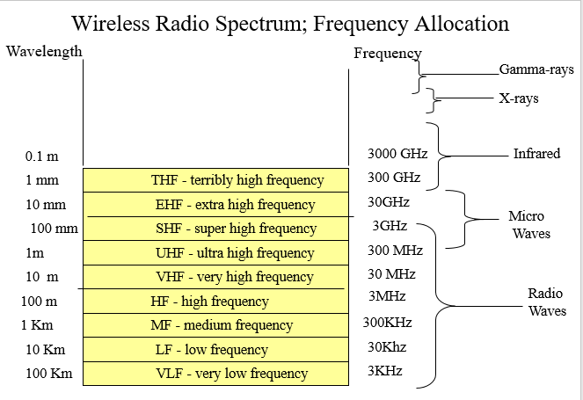

Slide 26
Cont..
Examples of Radio Waves
Radio Broadcasting. One of the prime applications of radio waves is radio broadcasting. ...
Cellular Networks. ...
RADAR. ...
Radio Astronomy. ...
Satellite Communication. ...
Radio Telemetry. ...
Remote Controlled Toys. ...
Navigation and Air Traffic Control.

Slide 27
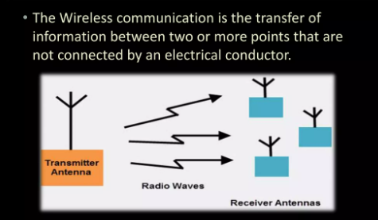
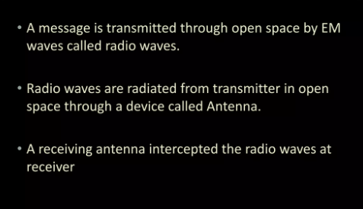
Cont.

Slide 28
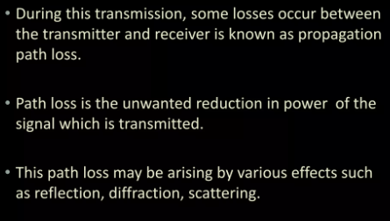
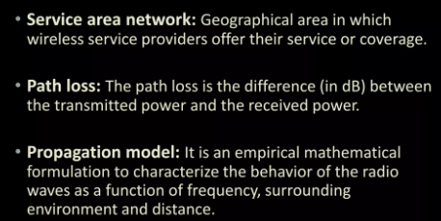
Cont..

Slide 29
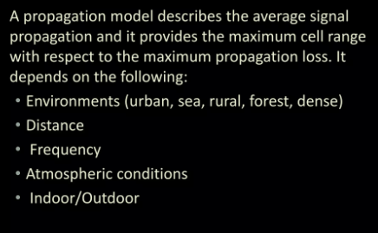
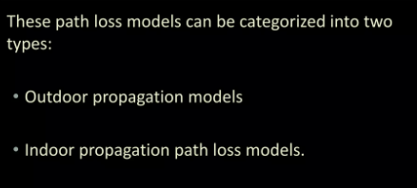
Cont.

Slide 30
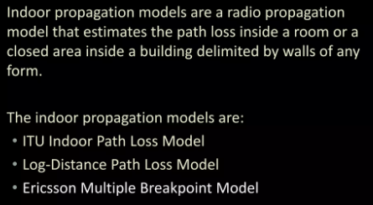
Indoor propagation models
Indoor Propagation model influenced by
Layout of the building
Construction material
Building types
Residential homes in suburban and urban areas
Traditional office buildings with fixed walls(hard partitions)
Open plan buildings with movable wall panels (soft partitions)
Factory buildings
Grocery stores
Retail stores
Sport arenas

Slide 31
Indoor Propagation
Indoor propagation is domited by the same mechanisms as outdoor reflection, scattering, diffraction.
However, conditions are much more variable
Doors/windows open or not
The mounting place of antenna desk, ceiling,etc.
The level of floors
Indoor channels are classified as
Line-of-sight (LOS)
Obstructed (OBS) with varying degrees of clutter.

Slide 32
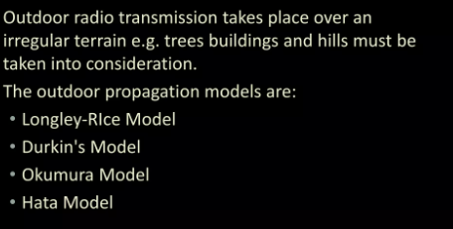
Outdoor propagation models
All such models predict the received signal strength at a particular distance or on a small sector.

Slide 33
In building path loss factors
Partition losses (same floor)
Partition losses between floors
Signal Penetration into Buildings
Partition Losses(same floor)
There are two kind of partition at the same floor
Hard partitions the walls of the rooms
Soft partitions moveable partitions that does not span to the ceiling
The path loss depends on the type of the partitions

Slide 34
In building path loss factors
Partition losses (same floor)
Partition losses between floors
Signal Penetration into Buildings
Partition Losses between Floors
The losses between floors of a building are determined by
External dimensions and materials of the building
Type of construction used to create floors
External surroundings
Number of windows
Presence of tinting on windows

Slide 35
In building path loss factors
Partition losses (same floor)
Partition losses between floors
Signal Penetration into Buildings
Signal Penetration Into Buildings
RF signals can penetrate from outside transmitter to the inside of buildings ,However the signals are attenuated
The path loss during penetration has been found to be a function of
Frequency of the signal
The height of the building

Slide 36
In building path loss factors
Effect of Frequency
Penetration loss decreases with increasing frequency
Effect of Height
Penetration loss decreases with the height of the building up-to some certain height
At lower heights, the urban clutter induces greater attenuation and then it increases Shadowing affects of adjacent buildings
Signal Penetration into Buildings

Slide 37
The end

Slide 38
Quiz 20’
List and define basic Propagation Mechanisms
List some Applications of free Space Wave Propagation
List Types of radio wave propagation
Define path loss
Define Multipath propagation

